Slide 1
Capstone Project
Western countries Financial Data Submitted
by
Ankit Singh

Slide 2
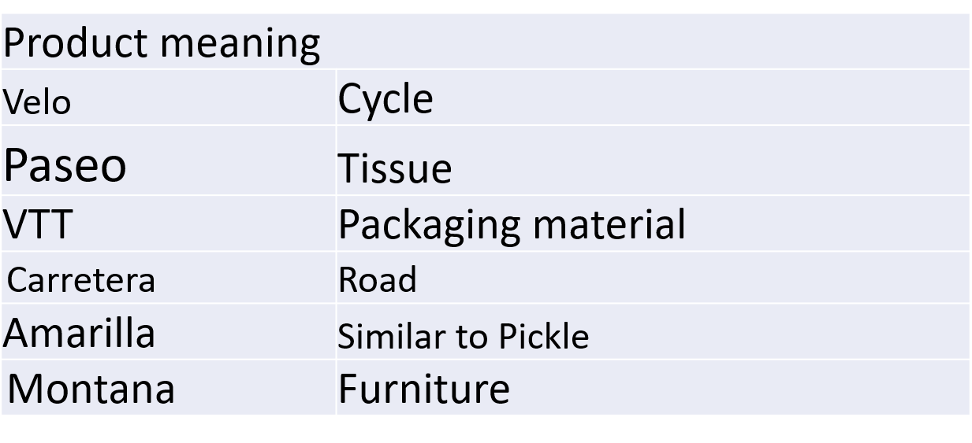
INTRODUCTION
It’s a Manufacturing company that Manufacture different Items because I Assume through Manufacturing Price.
There is two years of data.
The dataset talks abuts sales of 6th products across 5th country and 5th segments in 2013 & 2014.
The discount has been categorized as small, medium and high.
It also informs us of the manufacturing price and sales price including discount.

Slide 3
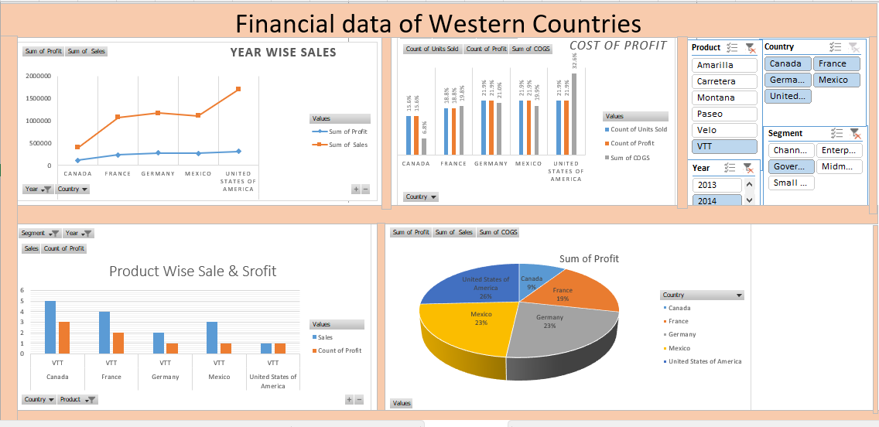
Excel Dashboard

Slide 4
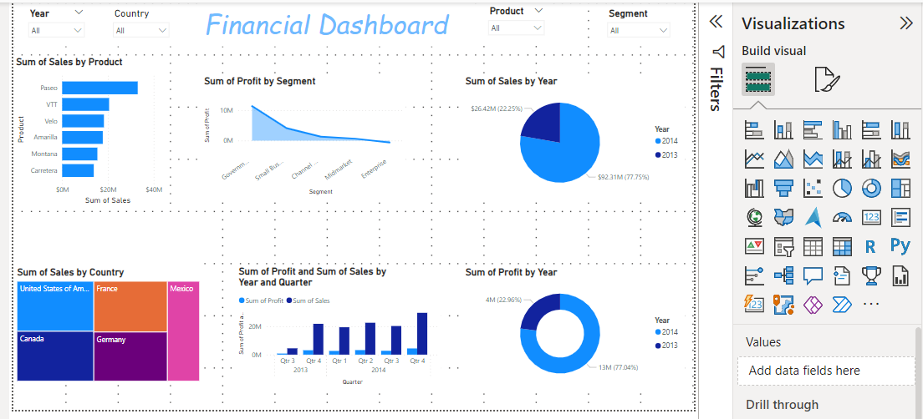
Dashboard in
Power BI, 1

Slide 5
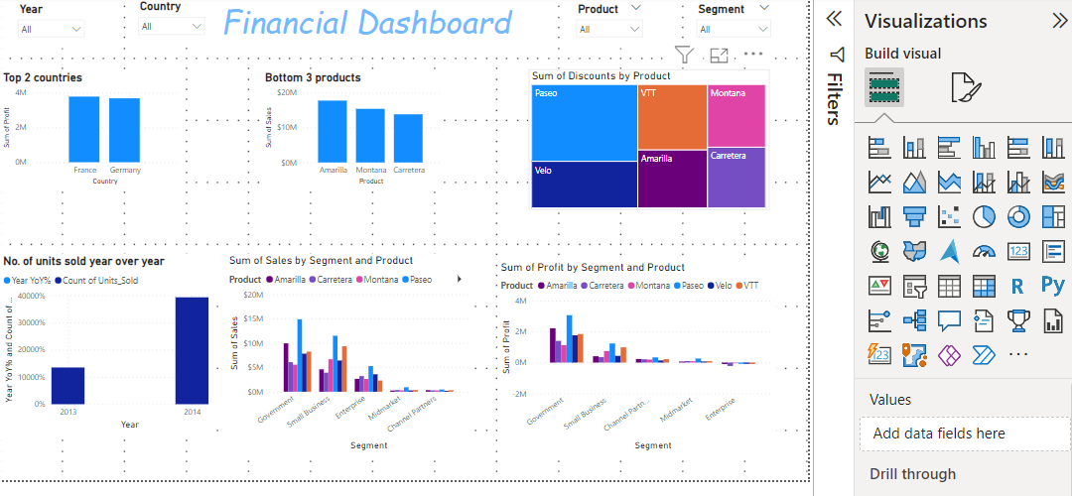
Dashboard in
Power Bi, 2

Slide 6
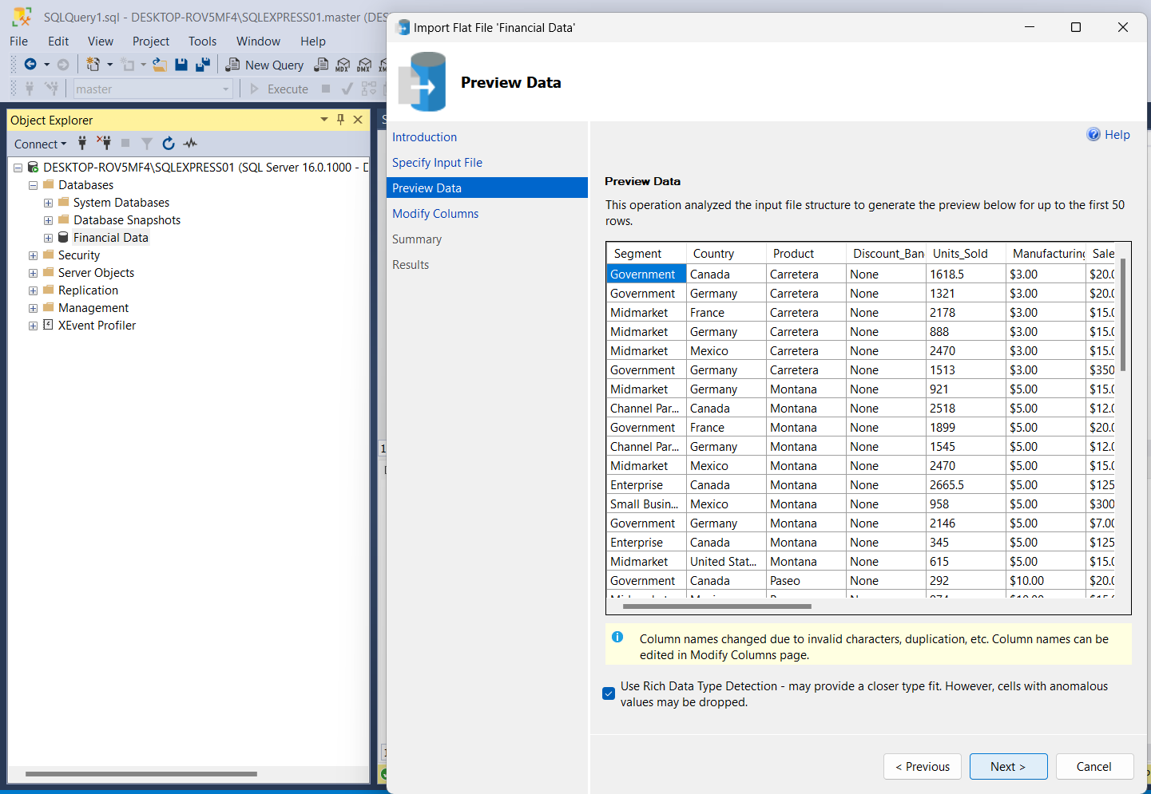
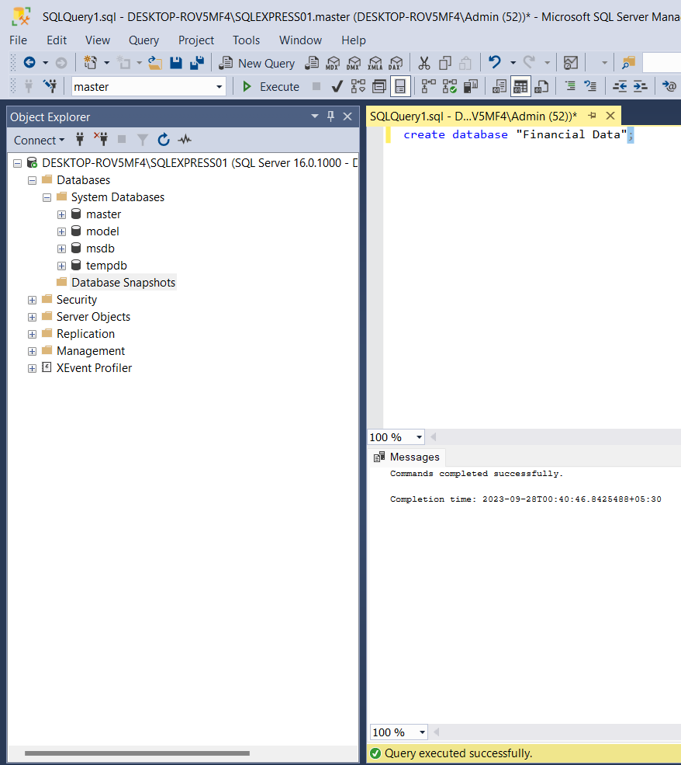
DATABASE IN SQL
IMPORT CSV FILE

Slide 7
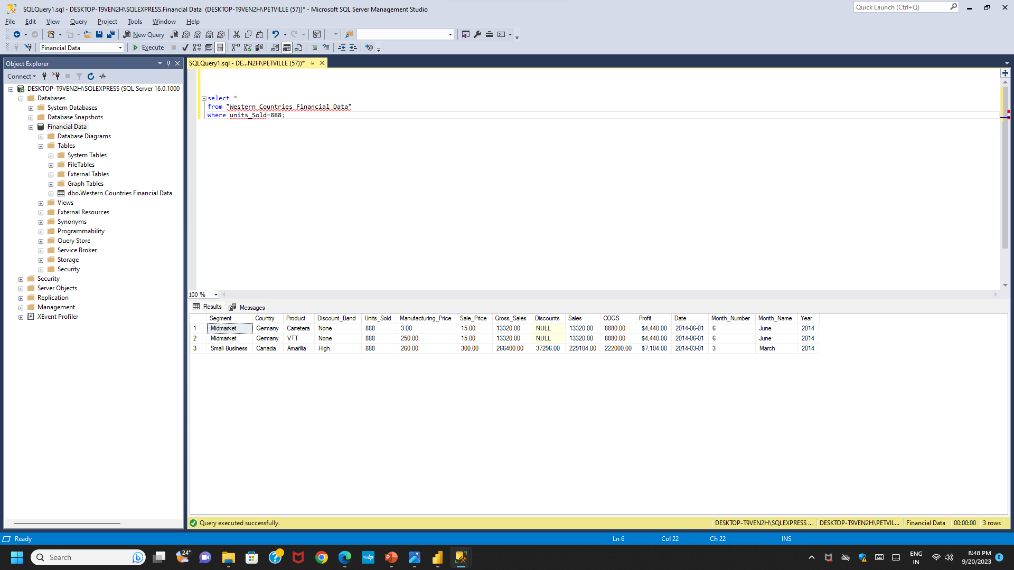
Query show only 888 , unit sold
select *
from "Western Countries Financial Data"
where units_Sold=888;

Slide 8
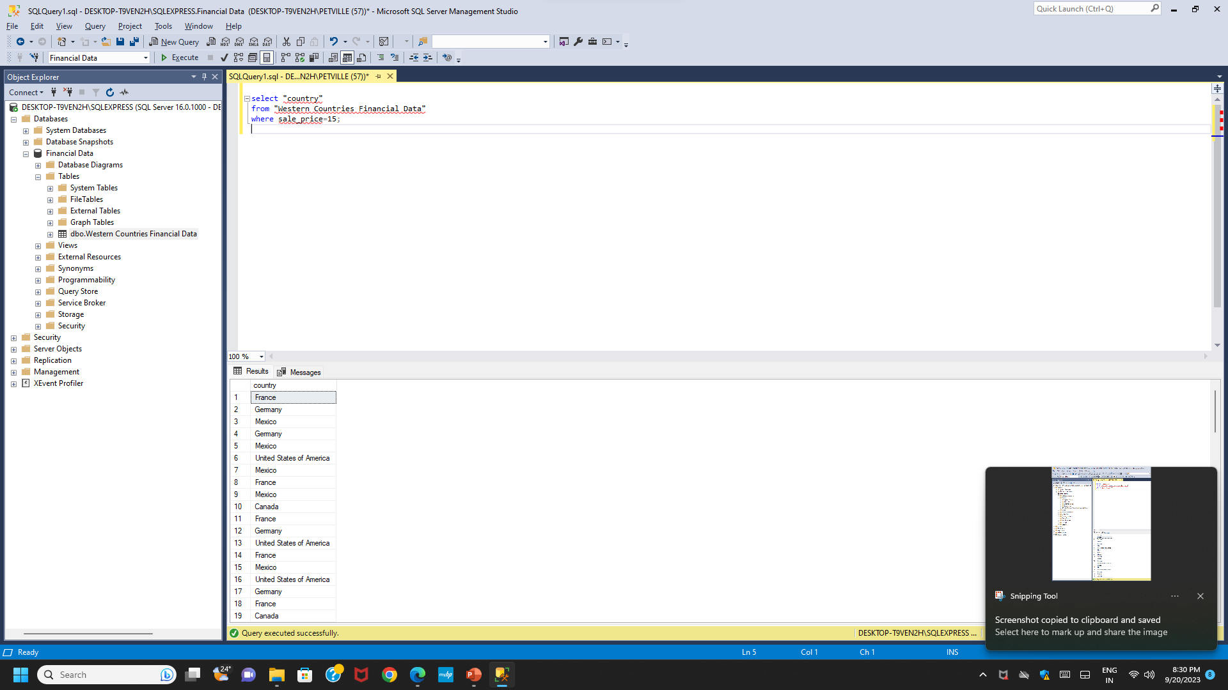
Query show sale price only 15,
select "country"
from "Western Countries Financial Data"
where sale_price=15;

Slide 9
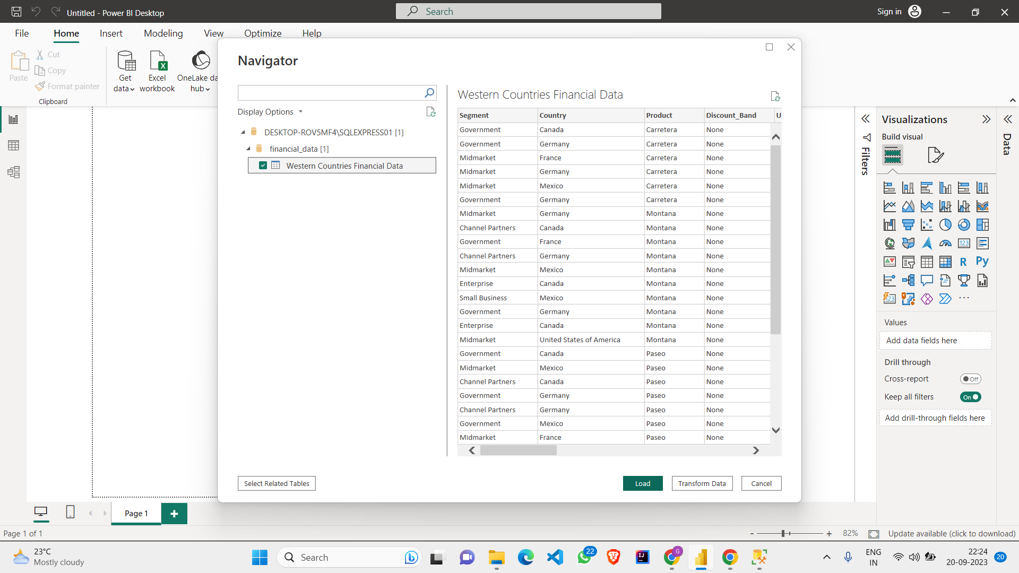
Import data from SQL Server to Power BI

Slide 10
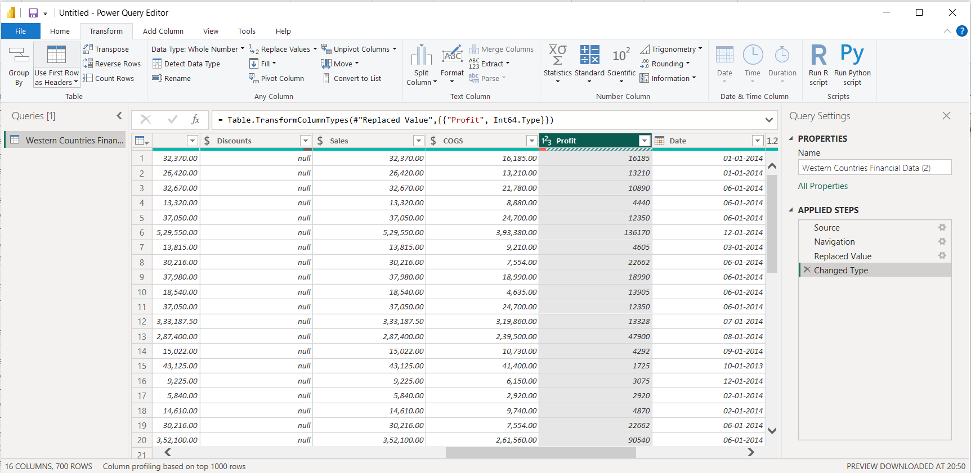
Transform the Data Profit Column Change From Text into Number Number

Slide 11
CONCLUSION
In 2013, Velo product sales were highest, and the Highest profit contribution for Velo product in Germany was 44% and lowest contribution in Canada 2.88. However it worth nothing that there are outliers in the Velo product prices, with a minimum price of 15, an average price of 162, and a maximum price of 350.
In both years the highest sales were achieved by Paseo, with Canada leading in terms of Profit 26.37% and lowest one in Germany 15.52% with Min Price 7 max price 350 Average price 106.93 Various discount were applied , with the highest discount being 53%, followed by 11% and 29%.

Slide 12
THANKYOU

